Slide 1


Health Education and Training
Tri-Service Hearing Technician
4.2 Certification Course

Slide 2
Health Education and Training
Learning Objectives
4.5.1 Become familiar with various training techniques for noise-exposed personnel
4.5.2 Describe critical considerations and regulatory requirements for crafting an effective health education message
Rate of recurrence
4.5.3 List specific mandated and optional topics that should be briefed:
Effects of noise (occupational/non-occupational)
HPDs
Audiometric monitoring
Tri-Service Hearing Technician 4.2.0.0 Certification Course

Slide 3
Health Education and Training
Introduction
Noise induced hearing loss (NIHL) and tinnitus are most common injuries in the military
  Both are largely under-recognized
Understand the threat = mitigate the threat
Effective education provides the knowledge and tools to prevent the “invisible” injury
Tri-Service Hearing Technician 4.2.0.0 Certification Course

Slide 4
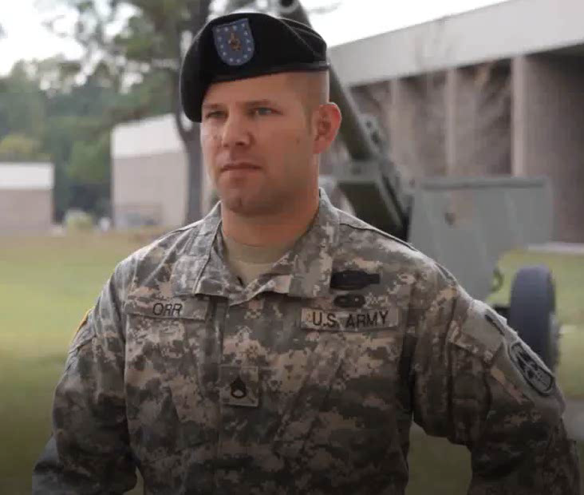
Health Education and Training
Testimonial
Education protects the individual and unit health
Preserves communication capabilities for job performance
Impacts mission accomplishment
Promotes safety
Tri-Service Hearing Technician 4.2.0.0 Certification Course
Notes:
45 second video

Slide 5
Health Education and Training
Mandated initial and Annual Training Topics
The effects of noise on hearing (on/off duty) and military operations
Hearing protection devices (HPDs)
  Purpose, advantages, disadvantages and attenuation characteristics of various types
  Instructions for proper fit, care and use
  Wear when exposed to hazardous noise both on/off duty
Audiometric testing
  Purpose, explanation of test procedures
  Interpretation of results
Impact hearing loss may have on career
Tri-Service Hearing Technician 4.2.0.0 Certification Course
Notes:
Topics IAW 29 CFR 1910.95 and DoDI 6055.12
Hearing loss and how it may lead to disqualification from current duties if hearing is critical to job performance; mandatory requirement of assigned protective equipment, administrative actions that may follow for failure to wear
Additional notes for Air Force personnel: Document all training on the worker’s AF Form 55, Record of Training, or equivalent - include all subjects covered by this slide and notes

Slide 6
Health Education and Training
Mandated initial and Annual Training Topics
Elements and rationale of the HCP
Effects of noise on hearing
Purpose, styles and proper use of various HPDs
Command and employee responsibilities for HC
Impact hearing loss may have on career, safety and mission
Off-duty hearing health practices (non-occupational noise)
Purpose of hearing tests and procedures
Service-specific requirements
Tri-Service Hearing Technician 4.2.0.0 Certification Course
Notes:
Shop/safety training requirement IAW DODI 6055.12

Slide 7
Health Education and Training
Recommended Briefing Topics
Overview of HCP services available
Importance of hearing for mission accomplishment
Anatomy, physiology and mechanism of hearing loss
Impact of hearing loss on communication during training, operational exercises, combat missions and work
Hearing loss prevention tactics and alternative HPD strategies
Noise surveillance and abatement strategies
Tri-Service Hearing Technician 4.2.0.0 Certification Course

Slide 8
Health Education and Training
Service Specific Training Requirements
Air Force - annual requirement for
  All noise exposed personnel – Further documented on the worker’s AF Form 55, Record of Training, or equivalent
  All workplace supervisors (trained by Public Health)
Army - required annually by all Active Duty and Operational (TOE) USAR and USANG personnel
  Training required regardless of MOS
  Mandated topics match 29 CFR 1910.95Navy - annual refresher training for all HCP enrolled personnel, military and civilian
Navy - annual refresher training for all HCP enrolled personnel, military and civilian
Marines - annual refresher training
Tri-Service Hearing Technician 4.2.0.0 Certification Course

Slide 9
Health Education and Training
Instructors
Personnel well-versed in all components of the hearing conservation program (HCP)
Audiologists/Hearing Conservation Program Managers (HCPMs)
Preventive medicine professionals
Occupational health
Safety officers
DoD certified hearing technicians/Occupational Hearing Conservationists (OHCs)
Tri-Service Hearing Technician 4.2.0.0 Certification Course

Slide 10
Health Education and Training
Recommended Briefing Topics
Noise exposure - signs and symptoms
  Ringing or buzzing ears (tinnitus)
  Ear pain
  Difficulty understanding conversational speech
  Need radio or television louder
  Complaining people mumble
Four P’s of noise-induced hearing loss
  Permanent, Painless, Progressive, Preventable
Tri-Service Hearing Technician 4.2.0.0 Certification Course

Slide 11
Health Education and Training
Tailor Training Material to Audience/Noise Environment
One brief does not suffice for all, vary brief with unit composition
Update and/or alter briefs year-to-year
Research unit before preparing brief
  Review unit hearing loss trends and occupations
Provide noise levels for equipment commonly used by unit
Include interesting facts
  Exposure levels are dependent on speed of tactical vehicle
  Location in aircraft will vary noise intensity levels, consider pilot, crew, passengers
Tri-Service Hearing Technician 4.2.0.0 Certification Course

Slide 12
Health Education and Training
Participants
Service members and DoD civilians - noise exposed
Army/Marine - Military are all noise-exposed
Navy & Air Force
  Defined as at risk for hazardous noise exposure > 85 dBA TWA or > 140 dBP
  Deploying personnel may be deemed at risk, test requirements will appear on reporting instructions
  Civilians - documented by industrial hygiene that exposure levels > 85 dBA TWA for at least 1 day annual or a one-time exposure > 140 dBP annually
Tri-Service Hearing Technician 4.2.0.0 Certification Course

Slide 13

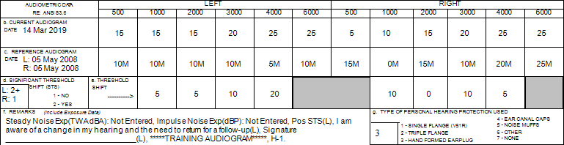
Health Education and Training
Emphasis of the Brief
Effects of noise on hearing - on and off duty
Hearing protection
  Purpose and use
  Advantages, disadvantages, attenuation and characteristics
  Selection, fitting, use and care
  Interaction with others forms of PPE (eyewear)
Audiometric testing - purpose and interpretation of results
Tri-Service Hearing Technician 4.2.0.0 Certification Course
Notes:
Hearing loss and how it may lead to disqualification from current duties if hearing is critical to job performance; mandatory requirement of assigned protective equipment, administrative actions that may follow for failure to wear
Additional notes for Air Force personnel: Document all training on the worker’s AF Form 55, Record of Training, or equivalent - include all subjects covered by this slide and notes
(Images: METC-generated (owned) graphics/photos)

Slide 14
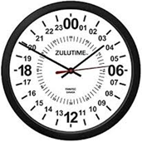
Health Education and Training
Techniques and Tips
Keep training
  Simple
  Short
  Meaningful - tailored to audience
Motivate - give attendees a specific reason to listen
Formal Training Time limits
  Recommend maximum of 15-30 minutes
  Review key items first
Tri-Service Hearing Technician 4.2.0.0 Certification Course
Notes:
Keys to successful hearing loss prevention training
Training attendees remember 70% of what is heard the first 20 minutes of training
(Image: amazon.com)

Slide 15
Health Education and Training
Briefing Formats
Informal - counseling current audiograms and/or earplug fittings
Formal - Small group (10 or less)
  Best scenario - small groups, short time
  Annual group hearing tests using training supplements
  Command groups
Formal - Large group (11 or more)
  Annual briefing conducted for group of personnel
  Tracked on large-scale metric for mandatory training
Tri-Service Hearing Technician 4.2.0.0 Certification Course

Slide 16
Health Education and Training
Documentation
All Services - DOEHRS-HC Reports/Lists
USA
  Sign-in rosters maintained by unit
  DTMS - Defense Training Management System entry
USN/USMC
  Sign-in rosters maintained by units and medical record
USAF
  AF Form 55, Record of Training, filed with workplace supervisor
  SF 600 and/or documented in the electronic health record
Tri-Service Hearing Technician 4.2.0.0 Certification Course

Slide 17
DOEHRS-HC Additional Functions 2
Summary
Training techniques/tips
Training content
  Rate of recurrence
List specific mandated/optional topics that should be briefed:
  Effects of noise (occupational/non-occupational)
  HPDs
  Audiometric monitoring
Tri-Service Hearing Technician 4.2.0.0 Certification Course

Slide 18
Health Education and Training
? Questions ?
Tri-Service Hearing Technician
4.2 Certification Course

